Slide 1
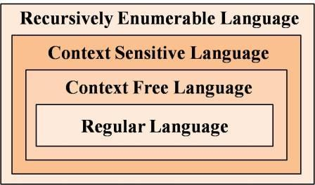
Simplifications of Context-Free Grammars
Course Instructor:
Dr. Sohail Iqbal

Slide 2
A Substitution Rule
Equivalent
grammar
Substitute

Slide 3
Substitute
Equivalent
grammar

Slide 4
In general:
Substitute
equivalent
grammar

Slide 5
Nullable Variables
Nullable Variable:
Example:
Nullable variable

Slide 6
Removing
Substitute
After we remove all the
all the nullable variables disappear
(except for the start variable)

Slide 7
Unit-Productions
Unit Production:
(a single variable in both sides)
Example:
Unit Productions

Slide 8
Removal of unit productions:
Substitute

Slide 9
Unit productions of form
can be removed immediately
Remove

Slide 10
Substitute

Slide 11
Remove repeated productions
Final grammar

Slide 12
Useless Productions
Useless Production
Some derivations never terminate...

Slide 13
Another grammar:
Useless Production
Not reachable from S

Slide 14
In general:
If there is a derivation
consists of
terminals
Then variable is useful
Otherwise, variable is useless

Slide 15
Practice: Exercise 2.1 to 2.10 from the Sipser’s book
Thank You!
Be ready for a surprise quiz in non-saturday class
Notes:
Note. a^n b^n c^n is CSL but not CFL.

